Slide 1


Flight Mechanics and Control Systems
Week 4: Lab 2
Dr. Hailong Huang
Assistant Professor
Department of Aeronautical and Aviation Engineering
The Hong Kong Polytechnic University

Slide 2
Lab 2
Week 2: Lab 1; Build a fixed-wing aircraft
Week 4: Lab 2; Coordinate system transformation
Week 5: Lab 3; Use forces and torques for aircraft control
Week 8: Lab 4; Use control surfaces for aircraft control
Week 10: Lab 5; Compute design models
Week 12: Lab 6; Autopilot design

Slide 3
Lab 2
Lab 2 is built upon Lab 1.
We add new content to your developed code in Lab 1.
Then, we create a model in Simulink.
Step 1: Implement the translation and rotation and integrate them as functions for easy calling.
Step 2: Use the provided Simulink model that takes the translation and rotation commands as input and to visualize the effects of the commands on the aircraft in real-time.

Slide 4
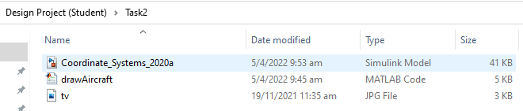
Lab 2
Two main files are available:
The file named as “Coordinate_Systems” is the Simulink model.
The file named as “drawAircraft” is an M file associated with the Simulink model. Some further work is required for this file.

Slide 5
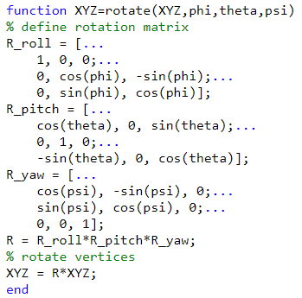

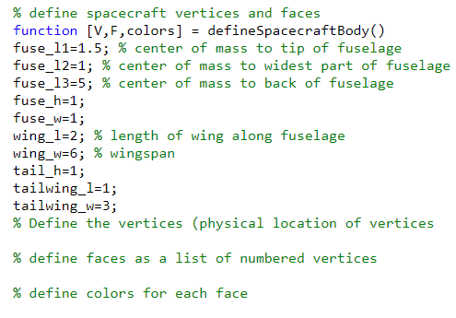



Lab 2
Step 1: Implement the translation and rotation as functions
？
Put $ℛ_{v2}^{b}$ here
XYZ should be a vector consisting of all the vertices of your aircraft
Put $ℛ_{v1}^{v2}$ here
Put $ℛ_{v}^{v1}$ here
？
An embedded function repmat() can be used
You have done these codes in Task 1
？
Updated (20 Sep 2023)
Input: phi, theta, phi
Input: pn, pe, pd
Input: Nil

Slide 6
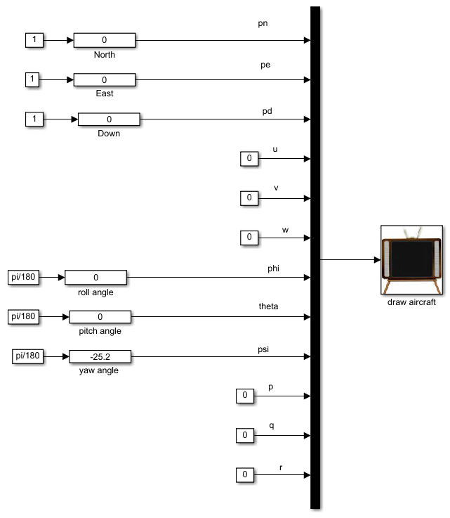
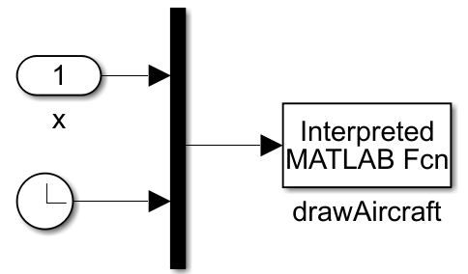
Lab 2
Step 2: Create a Simulink model
Translation
Not used now
Rotation
Not used now

Slide 7
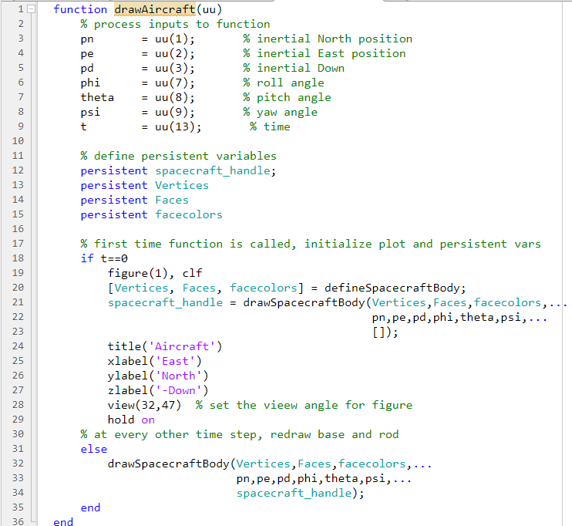
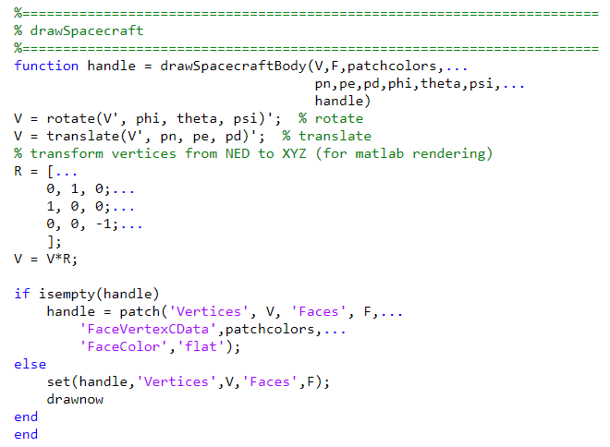
Lab 2
Main function

Slide 8
Lab 2
The logic of the Simulink model
Initially, we draw an aircraft without translation and rotation.
So, initially, we create a handle of the figure.
The timer is used to specify if we are at the initialization phase.
Whenever the translation and rotation commands are received,
we need to redraw, and we use the function of set.

Slide 9
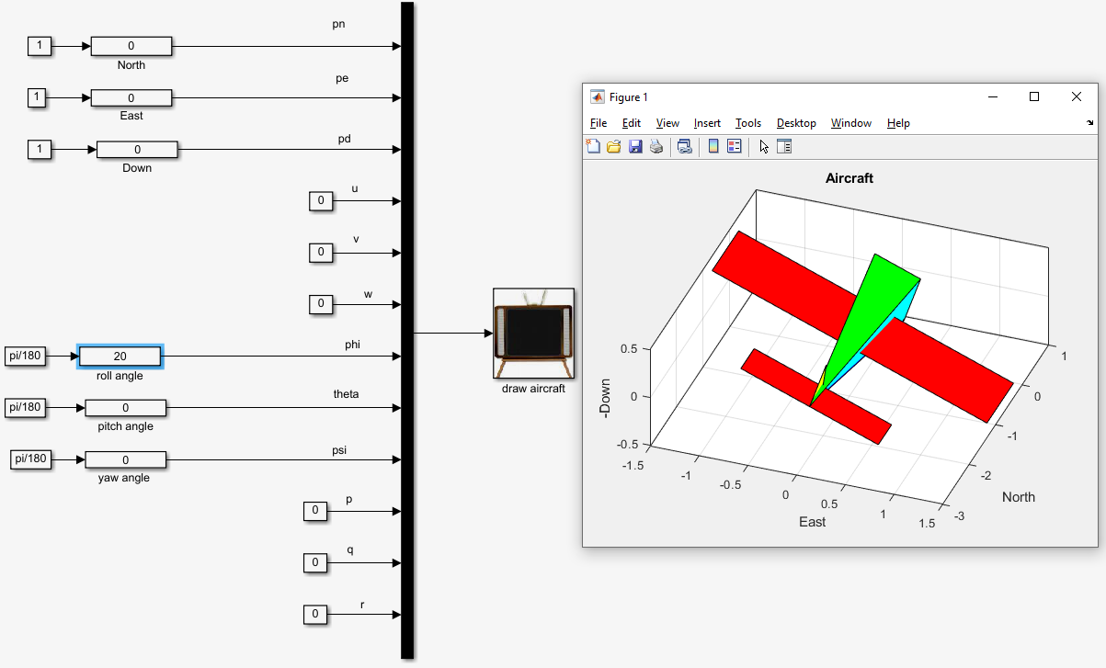
Expected result - 1
Lab 2

Slide 10
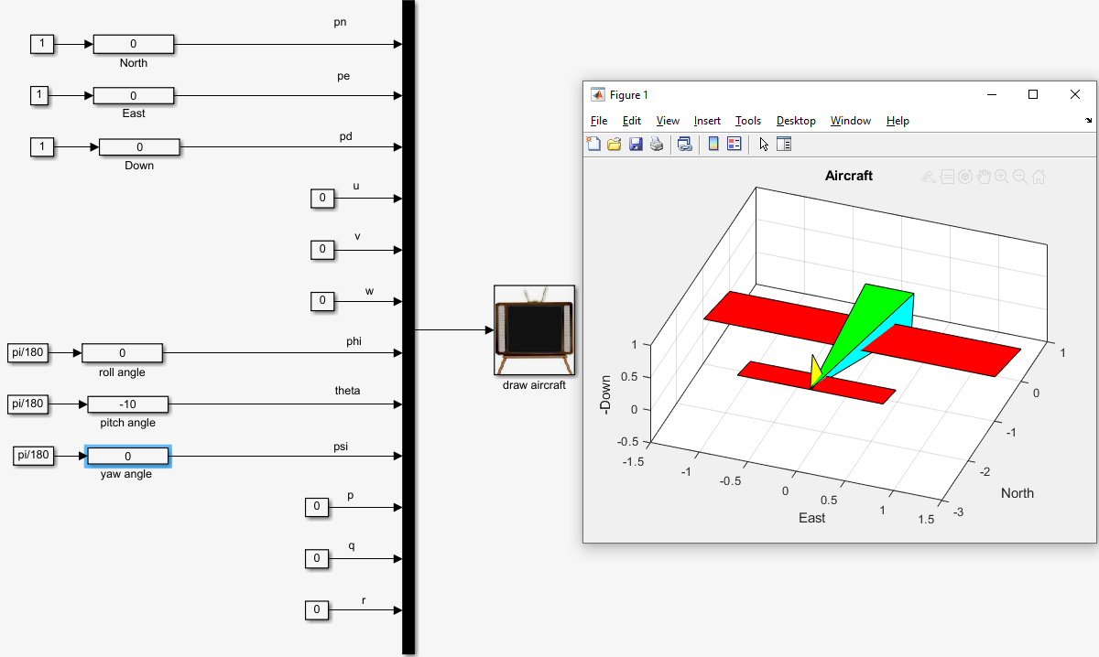
Expected result - 2
Lab 2

Slide 11
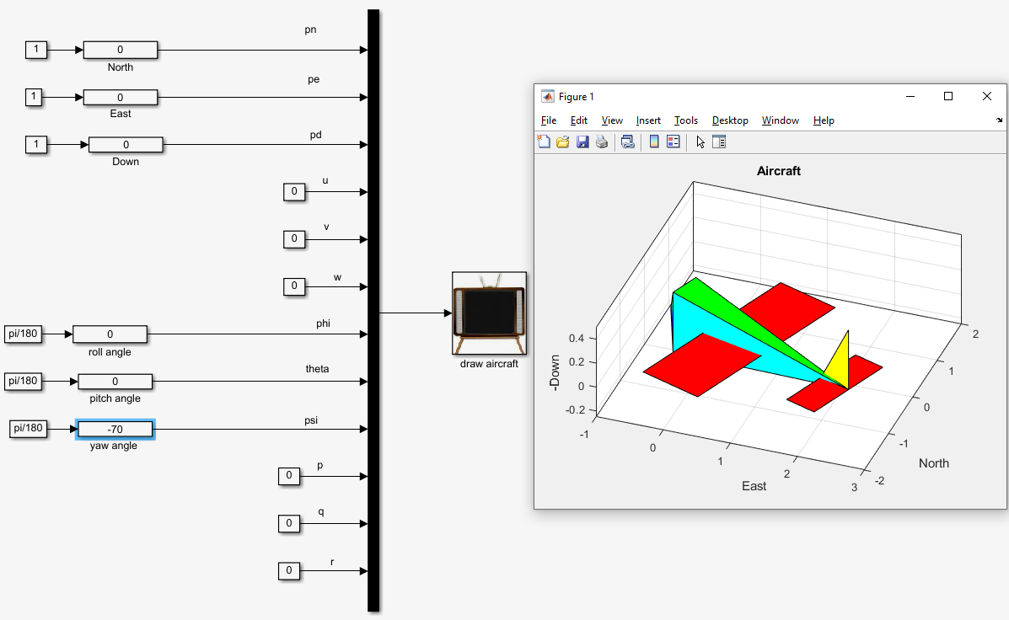
Expected result - 3
Lab 2

Slide 12
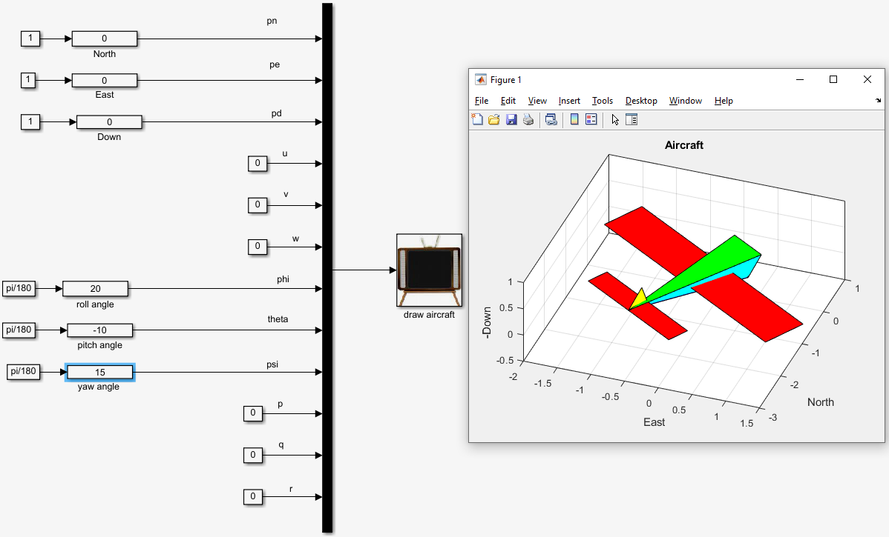
Expected result - 4
Lab 2
Show this result to a TA to get 1 mark

Slide 13
Thank You!
Dr. Hailong Huang
Assistant Professor
Department of Aeronautical and Aviation Engineering
The Hong Kong Polytechnic University
https://sites.google.com/view/hailong-huang/home
Email: hailong.huang@polyu.edu.hk

